Slide 1

Introduction to Entrepreneurship
Dr. Zunaira Saqib

Slide 2

Week 8 and 9: Business Model Canvas
Visual representation of company’s value proposition, infrastructure, customers, and finances

Slide 3

Setting Up Your Company in Pakistan
Single Member Company
Partnership

Slide 4
Types of Companies
Type of Company | Minimum Capital Required (PKR) | Time of Incorporation
Single Member Company | 100,000 | 4 Weeks
Private Limited Company | 100,000 | 6 Weeks
Public Listed Company | 200 Million | 6 Weeks

Slide 5
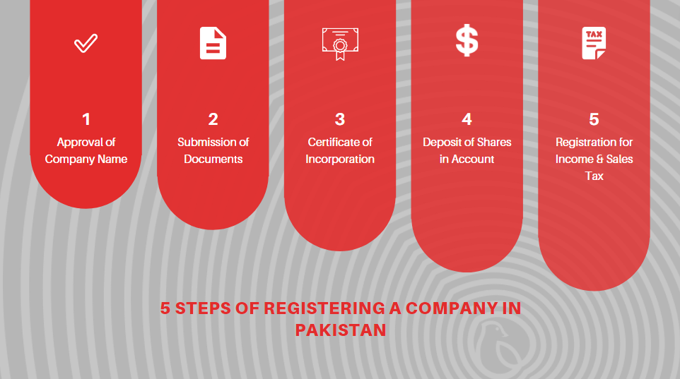
Process

Slide 6
10% Assignment
The 3 ideas that you have shortlisted / have got the feedback on it, Write about
The Problem You are Solving
Your Solution
Industry Insights (TAM, SAM, SOM)
Unique Selling Proposition
Cost Leadership or Differentiation
Target Market
2 Customer Personas
Group Assignment (FP Groups)
Word Limit = 2000 – 3000 Words
Follow the format as shared
Due: 26th April 2024, Friday, 1:30pm (LMS + Hard Copy)

Slide 7
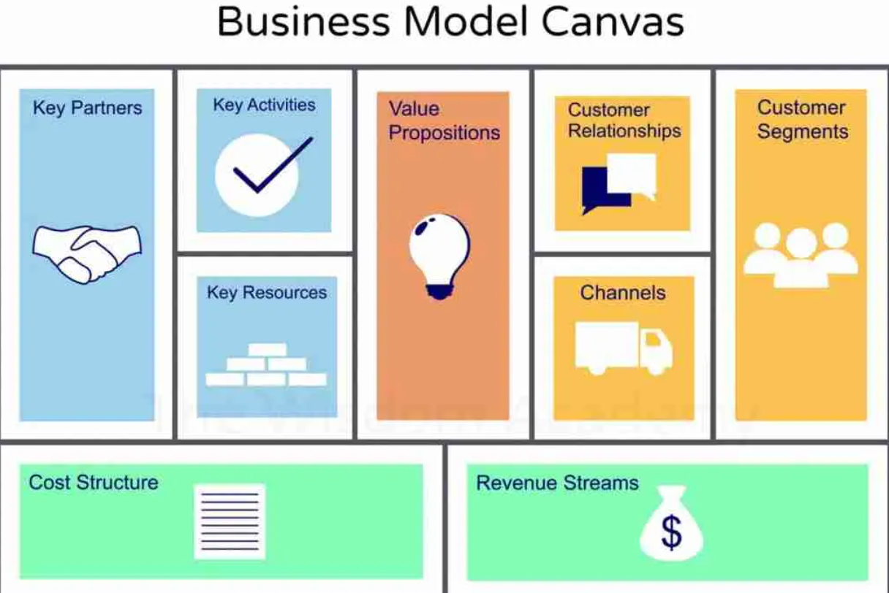

Slide 8
Business Model Canvas
It allows you to describe, design, challenge, invent, and pivot your business model.

Slide 9
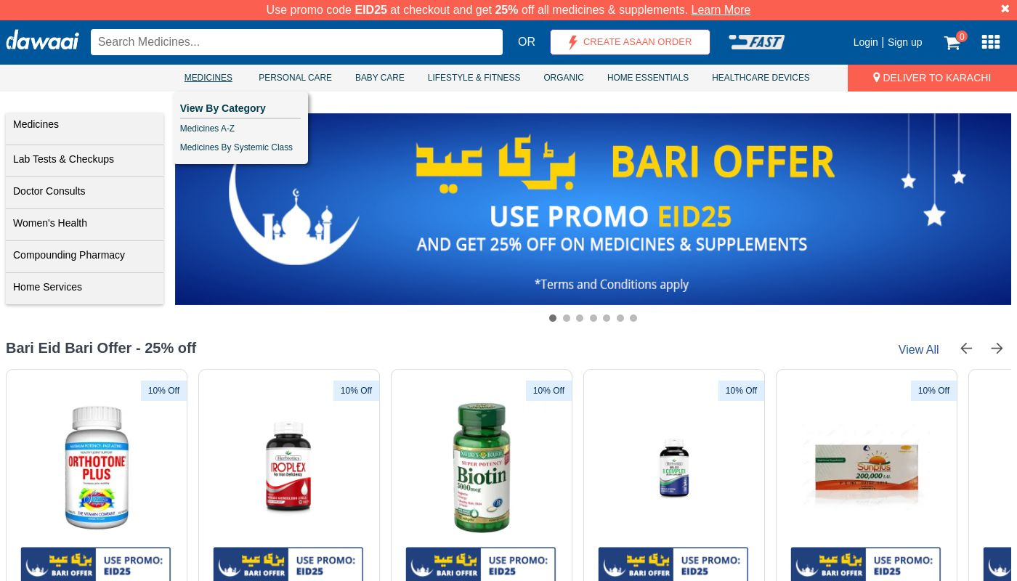


Product / Services to for Canvas
Dawaai
Bykea
Khaadi

Slide 10
https://www.youtube.com/watch?v=gq9761ua8Jc&ab_channel=VCastOnline
https://www.youtube.com/watch?v=6uDA8UrTPZM&ab_channel=Bykea

Slide 11
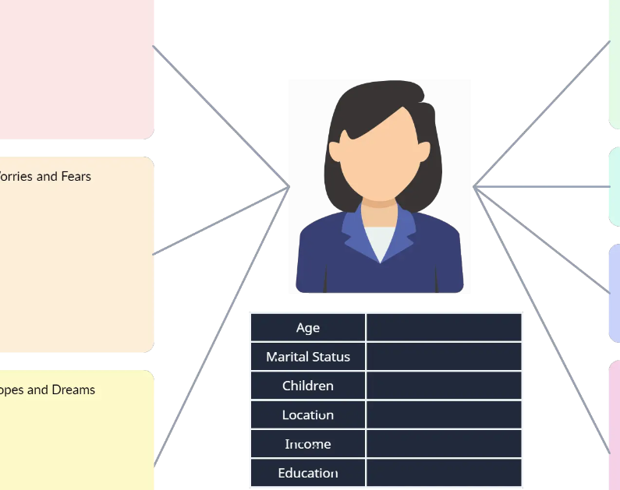
1. Customer Segments
Customer Segmenting is the practice of dividing a customer base into groups of individuals that are similar in specific ways, such as age, gender, interests and spending habits.
These are the groups of people or companies that you are trying to target and sell your product or service to.

Slide 12
1. Customer Segments
Mass market:
General population or a large group of people with similar needs.
For example, a product like a phone.
Niche market:
Specific group of people with unique needs and traits.
Buyers of high-end sports shoes.
Segmented:
Slightly different needs, there could be different groups within the main customer segment.
Diversified:
A diversified market segment includes customers with very different needs.
Multi-sided markets:
Interdependent customer segments.
A credit card company caters to both their credit card holders as well as merchants who accept those cards.

Slide 13
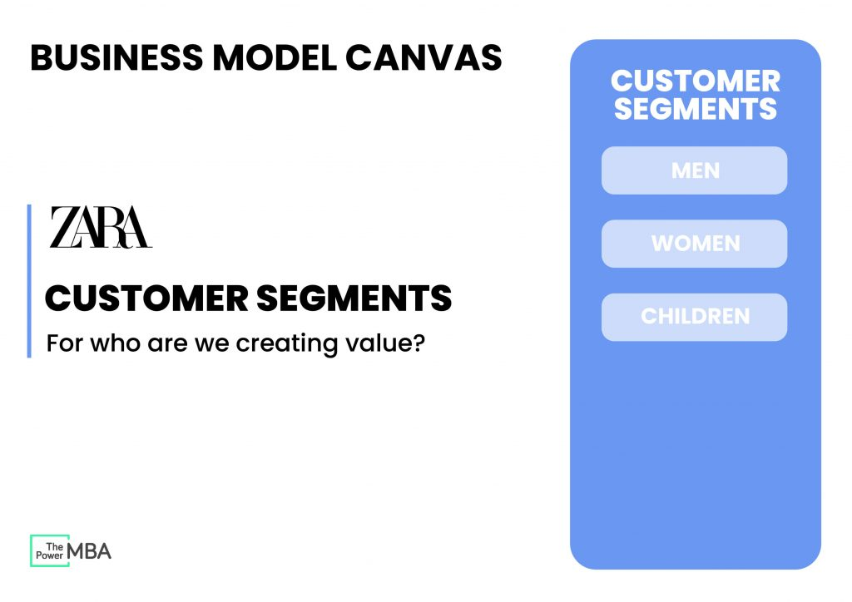

Slide 14

2. Value Proposition
Fundamental offering the company is trying to give its customers
The Value Proposition is foundational to any business/product.
It is the fundamental concept of the exchange of value between your business and your customer/clients.
Generally, value is exchanged from a customer for money when a problem is solved or pain is relieved for them by your business.

Slide 15

Value Proposition: Questions
What exactly is your company trying to give to customers?
What problem is your company trying to solve and what needs are your company satisfying?
How do you offer something different that satisfies the demands of your customer segments (e.g. price, quality, design, status, etc.)?

Slide 16
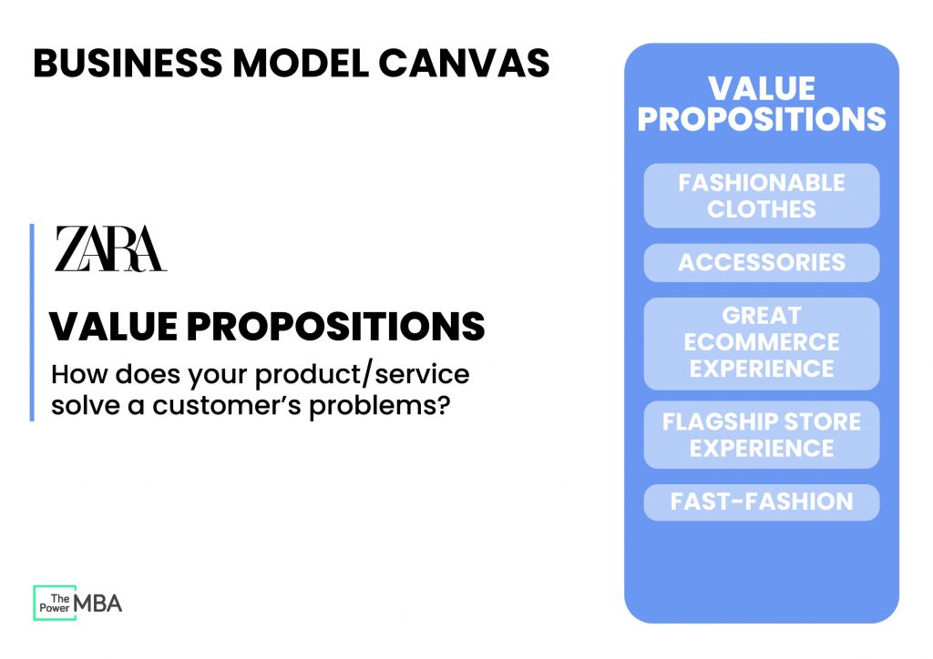

Slide 17
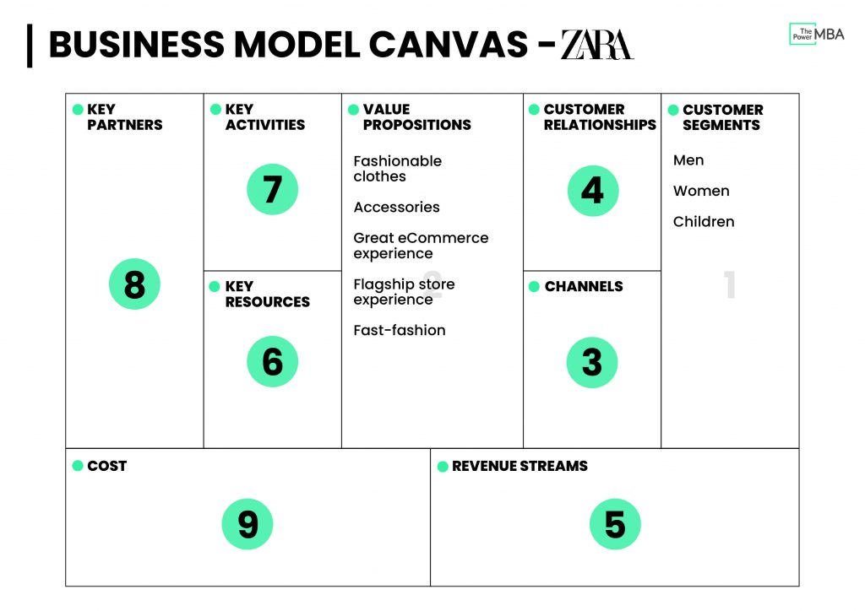

Slide 18

3. Channels
How your company will communicate with and reach out to your customers?
How are we going to tell our customer segment about our value proposition?

Slide 19

3. Example of Channels
Social media
Public speaking
Email marketing
Networking
SEM (Search Engine Marketing)
SEO (Search Engine Optimisation)
Viral marketing
Targeted blogs
Sales and promotions for commissions
Affiliates
PR
Trade shows
Content marketing
Offline advertising (billboards, TV, radio)

Slide 20


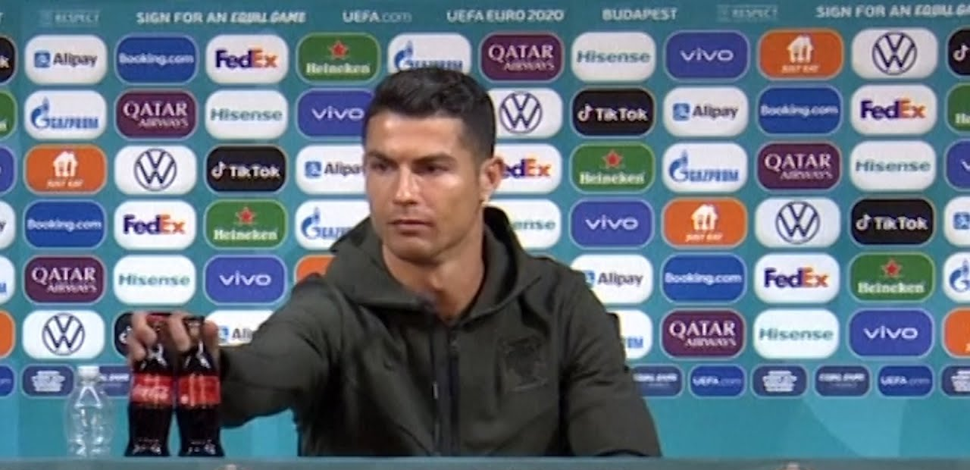
Social Media / Channels Gone Wrong
Dominos Employees Video
McDStories
Coca Cola and Ronaldo’s

Slide 21
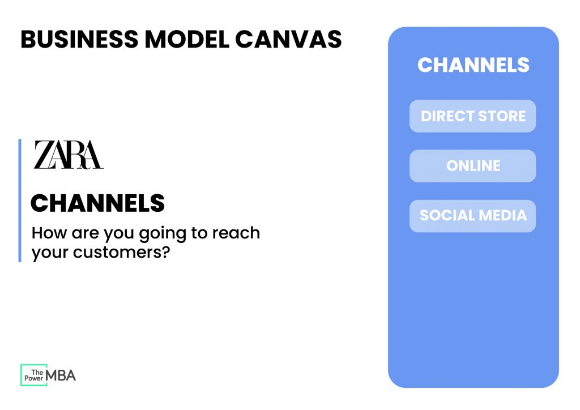

Slide 22
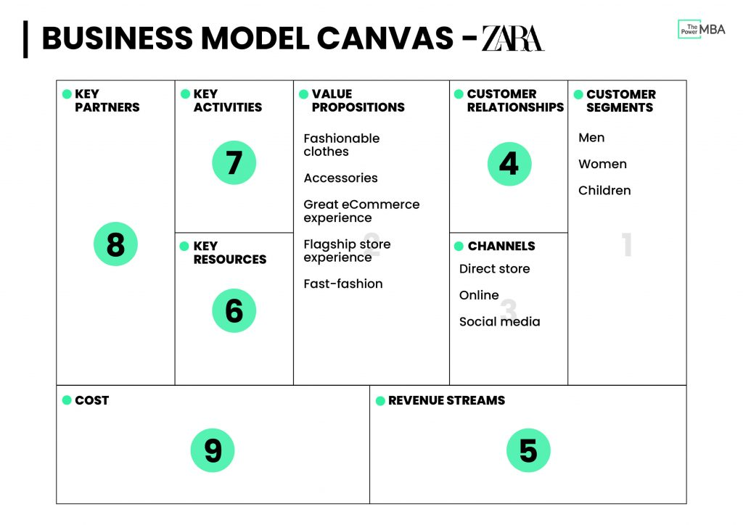

Slide 23

4. Customer Relationship
Need to establish the type of relationship you will have with each of your customer segments or how you will interact with them throughout their journey with your company.
Customer Relationships is defined as how a business interacts with its customers.

Slide 24

2. Customer Relationship
Personal assistance: You interact with the customer in person or by email, through phone call or other means. Nayatel
Dedicated personal assistance: You assign a dedicated customer representative to an individual customer. Priority Banking
Self-service: No relationship with the customer, but provides what the customer needs to help themselves. McDonald's
Automated services: Automated processes or machinery that helps customers perform services themselves. Individual Bank Customers
Communities: Online communities where customers can help each other solve their own problems Microsoft
Co-creation: Allows the customer to get involved in the designing or development of the product. Youtube

Slide 25
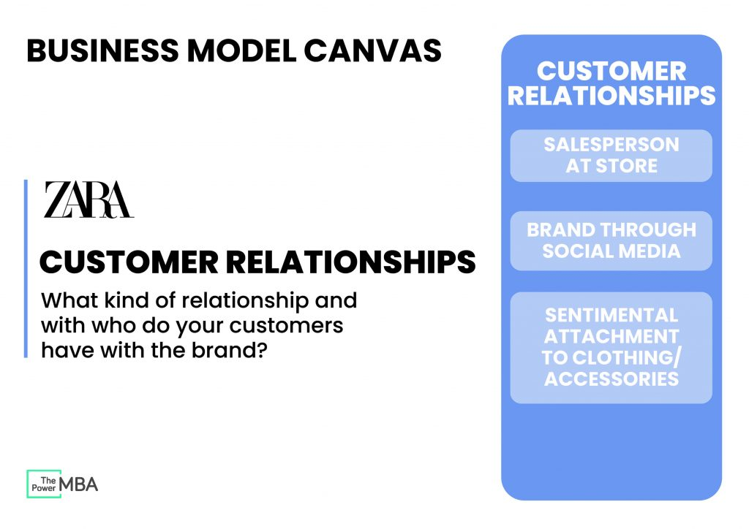

Slide 26
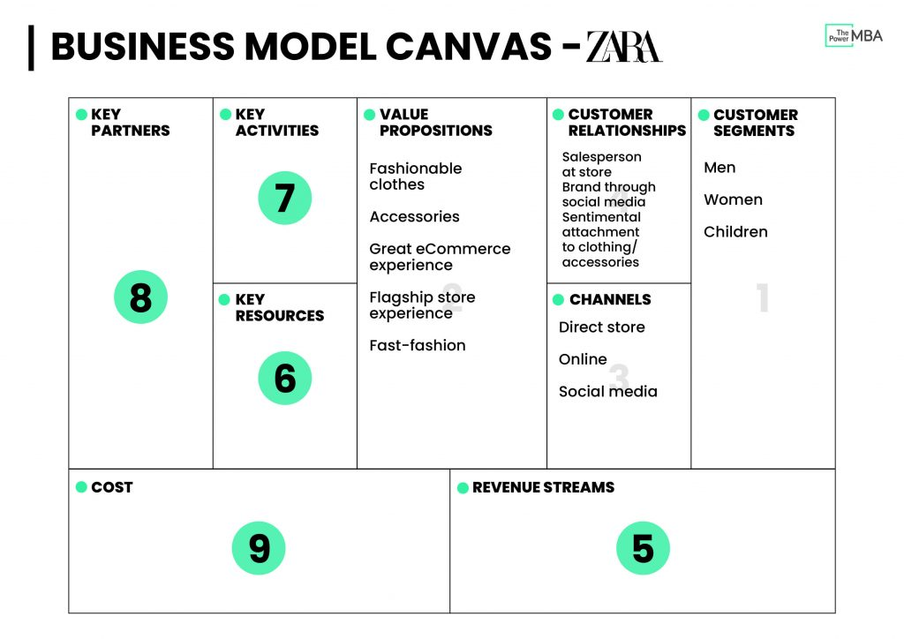

Slide 28

5. Revenue Stream
Revenue Streams are defined as the way by which your business converts your Value Proposition or solution to the customer’s problem into financial gain.
How do you gain revenue?

Slide 29
Revenue Streams
Asset sale: it is the most common source of income, the result of the sale of a physical product, which belongs to the customer.
Usage fee: Frequency of use of a particular service. The higher the use, the greater the amount paid by the customer.
Subscription fee: Sale of continuous access to a particular service.
Lending, renting, or leasing: Client has the right to temporary access to a particular resource.
Licensing: Allowed to use a protected, for-profit intellectual property by paying a fee.
Brokerage fee: this revenue stream provides a percentage of the value of a service executed, through intermediation between the parties.

Slide 30
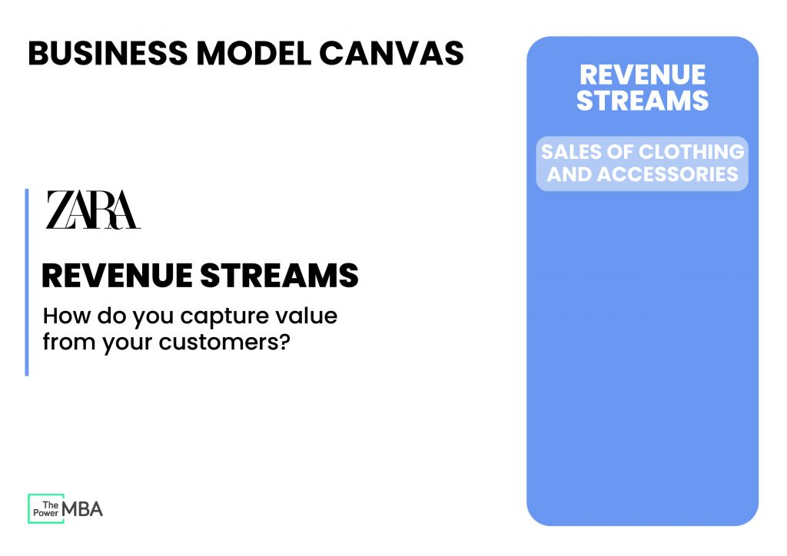

Slide 31
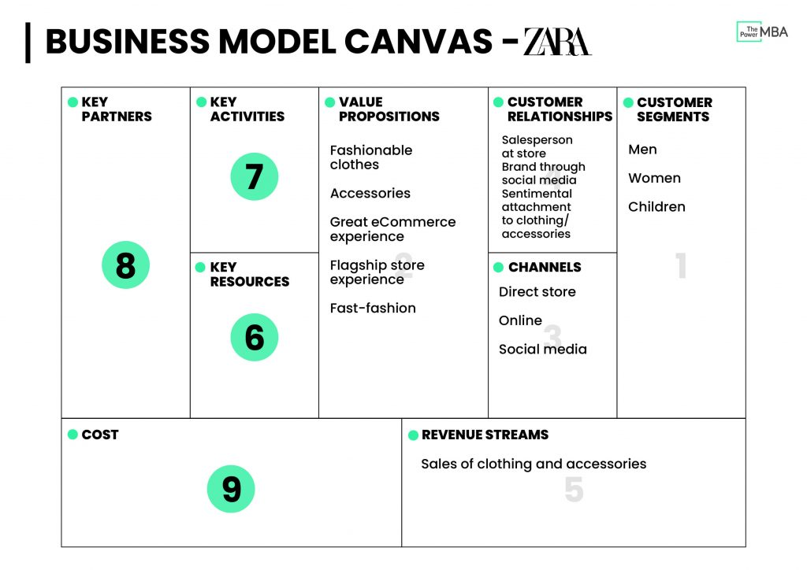

Slide 32

6. Key Resources
Practical resources are needed to achieve the key activities (actions) of the business.
Key means the resources your business requires to do business.

Slide 33
6. Key Resources
Human (employees)
Financial (cash, lines of credit, etc.)
Intellectual (brand, patents, IP, copyright)
Physical (equipment, inventory, buildings)

Slide 34
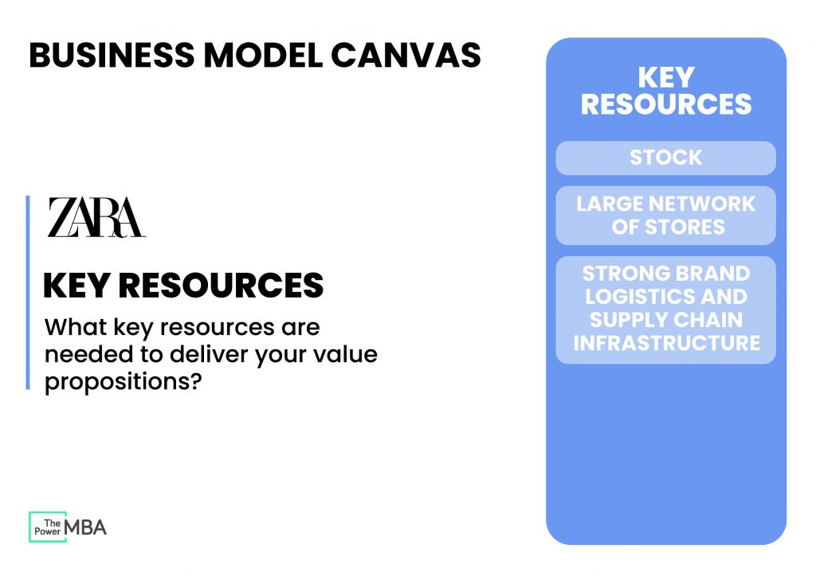

Slide 35
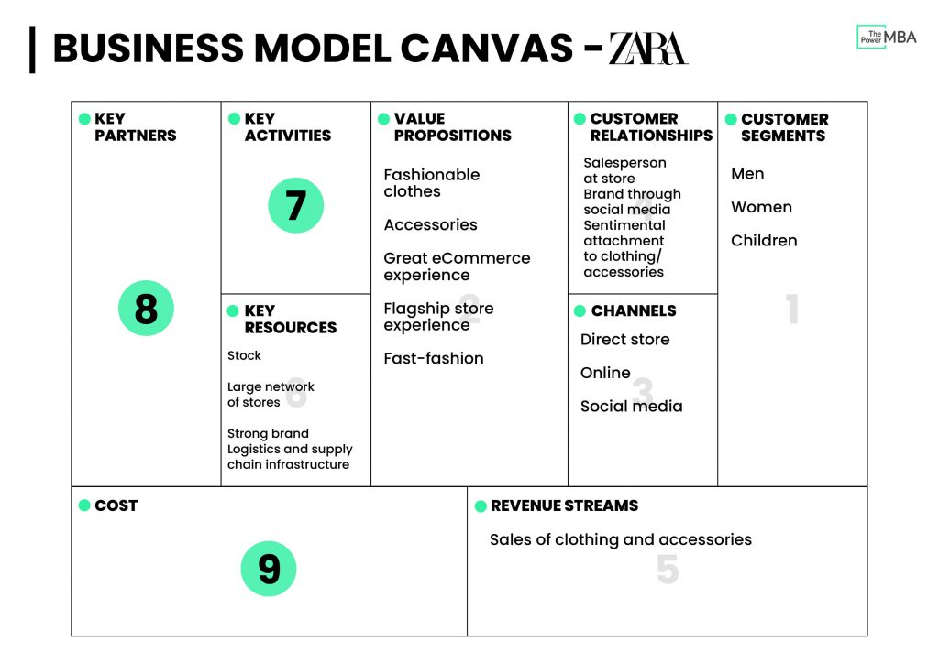

Slide 36
7. Key Activities
What are the activities/ tasks that need to be completed to fulfil your business purpose?
The Key Activities of your business/product are the actions that your business undertakes to achieve the value proposition for your customers.
Questions to ask:
What activities does the business undertake in achieving the value proposition for the customer?
What is the resource used?
Time and Expertise?
Distribution of product?
Technical development?
What actions does it take you and/or your staff to achieve value exchange?
Examples: Consulting, Designing, Web development, Baking, Driving

Slide 37

7. Key Activities
1. Production:
Designing, manufacturing and delivering a product in significant quantities and/ or of superior quality.
2. Problem-solving:
Finding new solutions to individual problems faced by customers.
3. Platform/ network:
Creating and maintaining platforms.

Slide 38
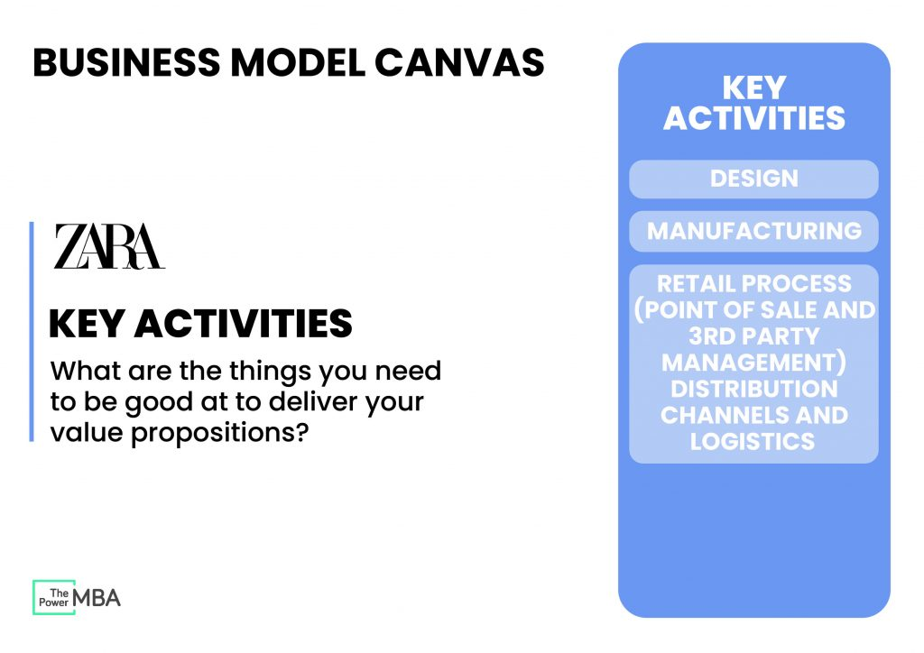

Slide 39
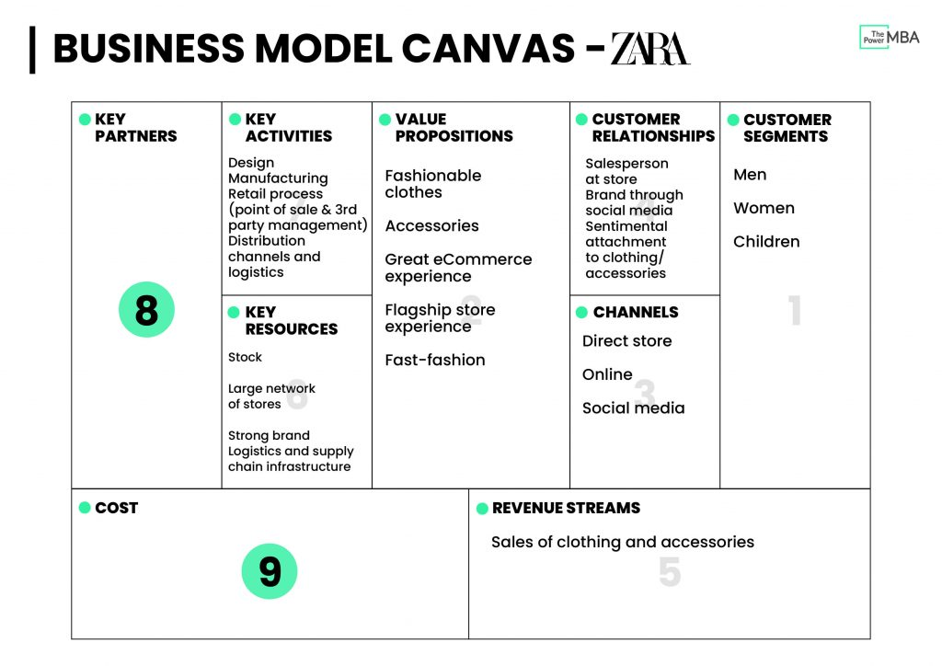

Slide 40
8. Key Partners
Key Partners are external companies/suppliers/parties you may need to achieve your key activities
An example of this is ‘if I sell groceries to customers, I may need a local baker to supply fresh bread to my store’.
They are a key partner to achieve the value my business promises to the customer.

Slide 41

Who are the key partners?
A Retail Store Selling Groceries
A Computer Shop
An Auto Shop
A Call Center
A Fast Food Store

Slide 42
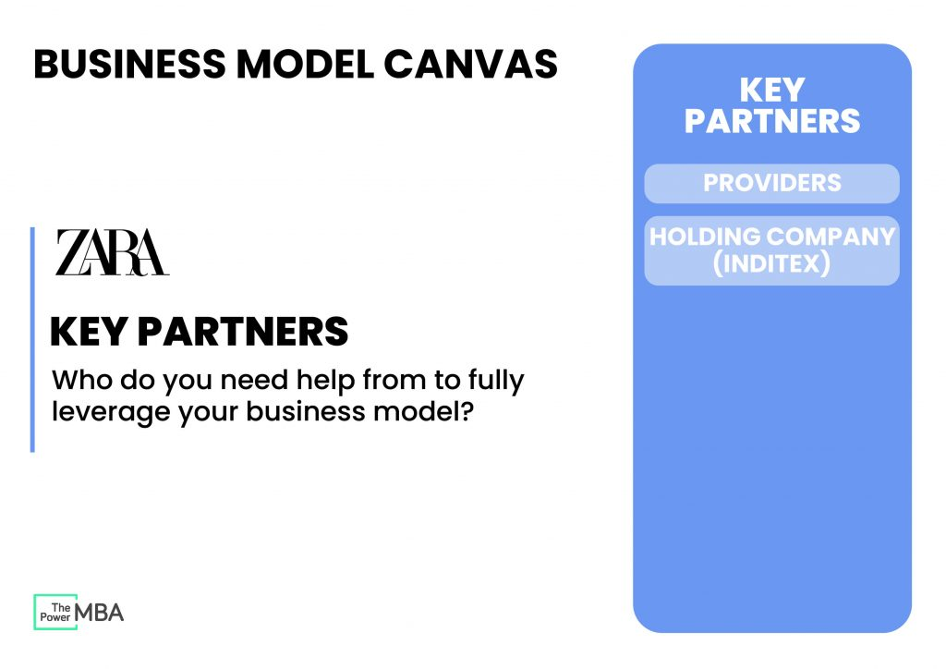

Slide 43
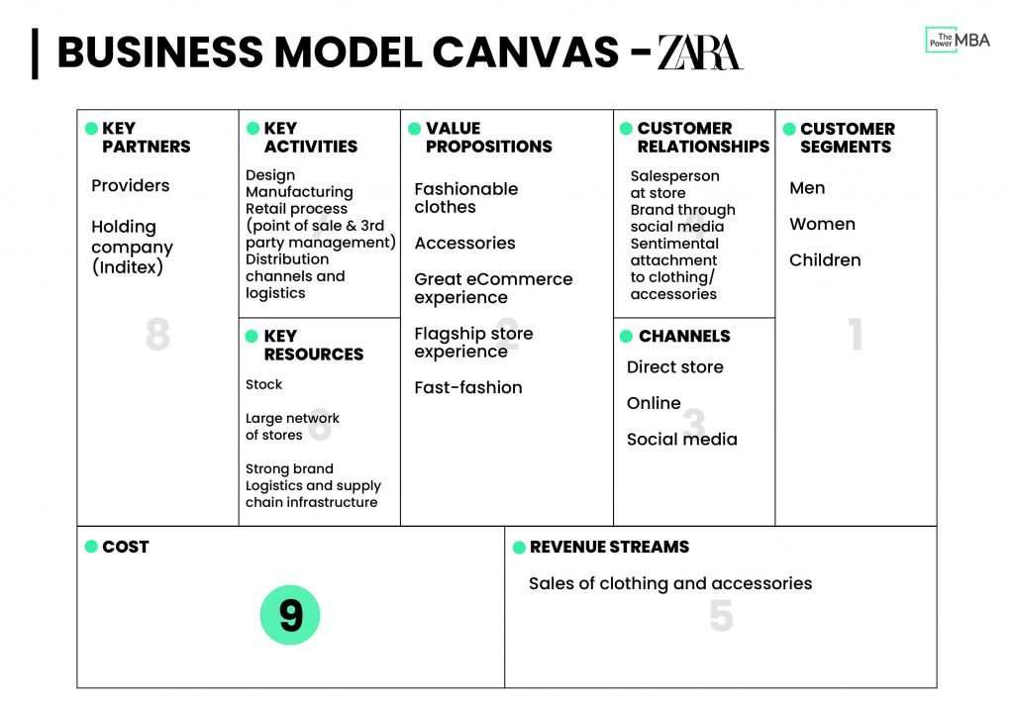

Slide 44

9. Cost Structure
Your business cost structure is defined as the monetary cost of operating as a business.
How much does it cost to achieve my business's key activities?
What is the cost of my key resources and key partnerships?
How much does it cost to achieve the value proposition for my customers/users?
Are there additional costs to running a business?
Legal?
Insurance?
What is the cost of my business?
It is important also to place a monetary value on your time as a cost. How much would it cost you to hire you?
What is the opportunity cost of running your business?

Slide 45
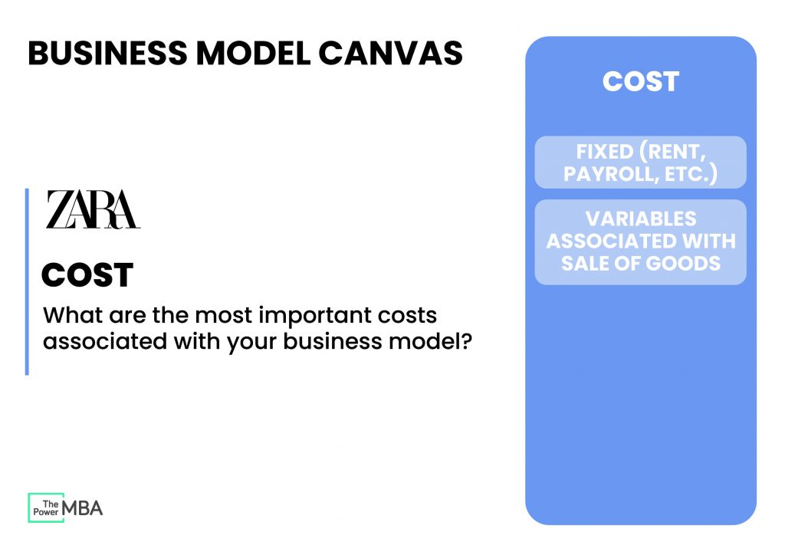

Slide 46
